Slide 1

INTRODUCTION TO PYTHON
CodeX Computing & Co.
Python Spring Internship – 2025
Batch A
https://codexcomputingco.unaux.com/
computingcodex@gmail.com

Slide 2

Python is a powerful modern computer programming language. It allows you to use variables without declaring them (i.e., it determines types implicitly), and it relies on indentation as a control structure.
You are not forced to define classes in Python (unlike Java) but you are free to do so when convenient

Slide 3
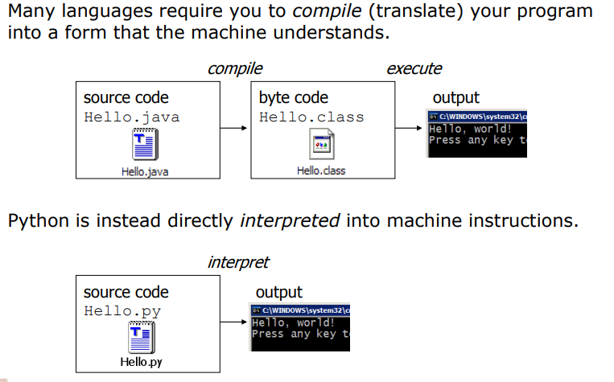
COMPILING AND INTERPRETING

Slide 4
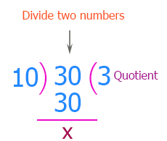
Write a C++ program to print the quotient of following numbers

Slide 5
C++
Python
#include <iostream>
using namespace std;
int main()
{
int a;
int b;
int q;
a=30;
b=10;
q=a/b;
cout<<q;
}
a=30
b=10
q=a//b
print(q)
print (type(a))

Slide 6
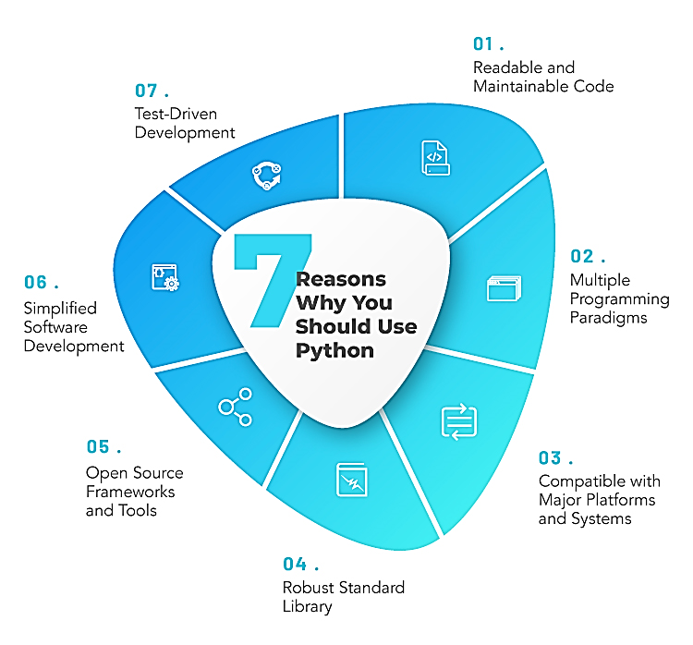
FEATURES
Open source general-purpose language.
Object Oriented, Procedural, Functional
Easy to interface with C/ObjC/Java/Fortran
Easy-ish to interface with C++ (via SWIG)
Great interactive environment
Easier to learn
Simple Elegant Syntax
Great Community and Support

Slide 7
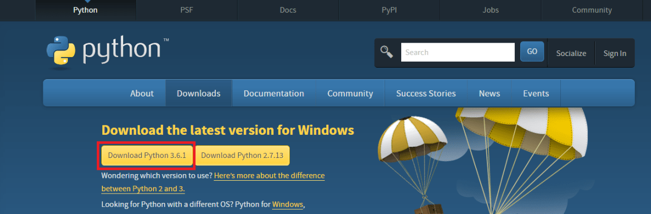
Downloads:
http://www.python.org
Documentation:
http://www.python.org/doc/
Python 3.6.13(Lab)
Python 3.8.8 cannot be used on Windows XP or earlier.

Slide 8
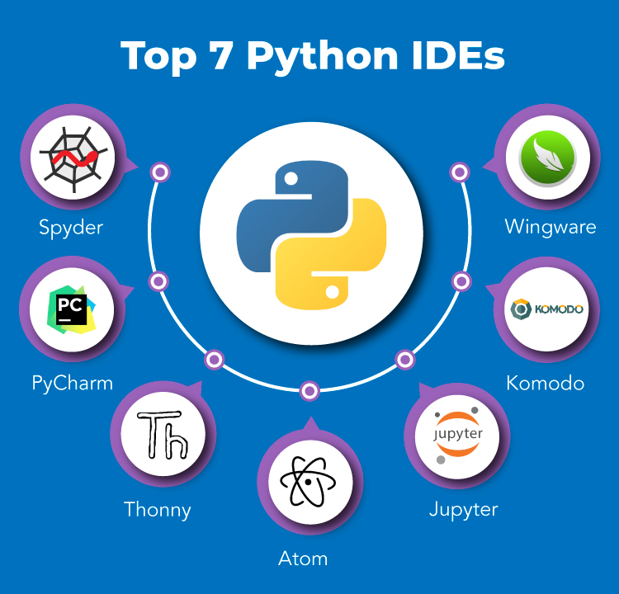
Python IDEs
Jupyter Notebook Using Anaconda Prompt

Slide 9
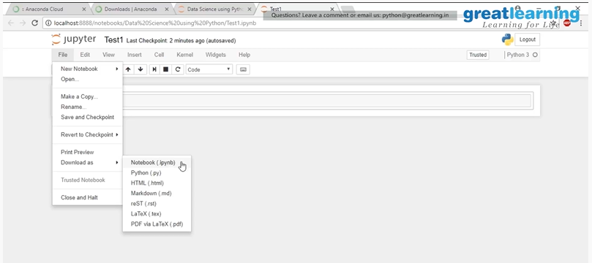
Functionalities in a Python Notebook (Jupyter)

Slide 10
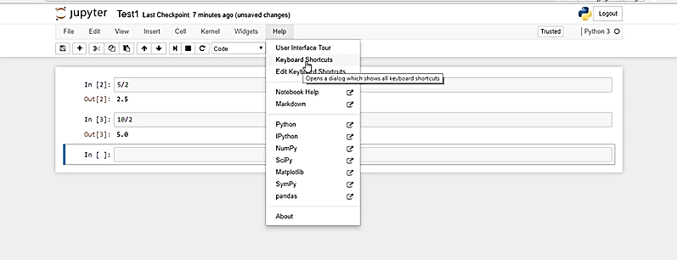
Functionalities in a Python Notebook (Jupyter)

Slide 11
INPUT FROM USER
In python, input() function is a built-in function for taking input from user. When this function is called, the program stops and waits for receiving a input.
Example
i = input() print(i)
Note: It is a better to print a prompt telling the user what is the input they should enter .
name = input('Enter your name?\n') Enter your name? Mr. X >>> print(name) Mr. X

Slide 12
PYTHON VALUES, VARIABLES AND TYPES
A value is one of the most basic things in any program
A value may be characters i.e. ‘Hello, World!’ or
A number like 1,2.2 ,3.5 etc.
Values belong to different types: 1 is an integer, 2 is a float and ‘Hello, World!’ is a string etc.
Alpha-Numeric Values

Slide 13
PYTHON NUMBERS
Python supports 3 types of numbers: integers, float and complex number.
If you want to know what type a value has you can use type() function.
print(type(1))
print(type(2.2))
print(type(complex(2,3)))

Slide 14
PYTHON STRING
Strings are defined either with a single quote or a double quotes.
The difference between the two is that using double quotes makes it easy to include apostrophes.
print(type('Hello 20K Batch'))
print(type(“Programming in AI String test"))

Slide 15
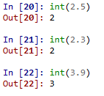


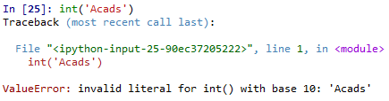
Type Conversion Examples
Note that float to int conversion
is truncation, not rounding off

Slide 16
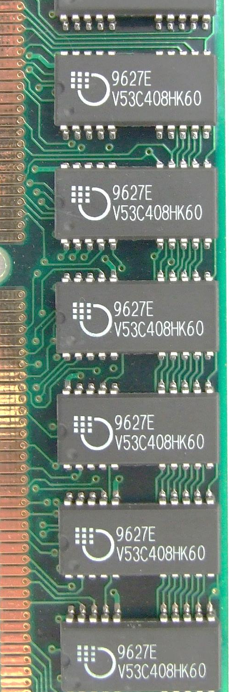
Variables
m
A name associated with an object
Assignment used for binding
m = 64;
c = ‘Acads’;
f = 3.1416;
Variables can change their bindings
f = 2.7183;
64
Acads
c
3.1416
f
2.7183

Slide 17
Variables
Python variables are containers to hold data. These assigned data value to a variable can be changed at a later stage.
The first assignment of value to a variable creates the variable. There is no explicit declaration of variable.
Conventions
Variable names follow these conventions.
Variable name begins with letter or underscore character not number and hyypen
Alpha-numeric and underscores are allowed in the rest of name
Variable names are case-sensitive

Slide 18
Reserved Words
You cannot use reserved words as variable names / identifiers
False class return is finally
None if for lambda continue
True def from while nonlocal
and del global not with
as elif try or yield
assert else import pass break
except in raise

Slide 19
Variable Conventions
# valid names
numOfBoxes = 7
_num_of_boxes = 10 # this is a different variable than numOfBoxes
_NUM_OF_BOXES = 15 # a different variable as names are case sensitive
ownerName = “Atif"
ownerName2 = “Muneeba" # different, valid variable
# invalid names
2ownerName = “Saeeda" # cannot start with number.
# Only letter or underscore in the beginning
owner-name = “Bilal" # no hypen
owner name = “Umer" # no space allowed
# only alpha numeric and underscore

Slide 20
Statements:
Statements are instructions that Python interpreter can execute.
We have already seen two kinds of statements: print and assignment.
There are other kinds of statements like if statement, for statement, while statement etc.
print(100) x = 200 y=400 100 600 z=x+y print(z)

Slide 21
PYTHON OPERATORS AND EXPRESSIONS
Python has so many built-in operators to perform different arithmetic and logical operations. There are mainly 7 types of operators in Python.

Slide 22
Operators
+ | - | * | // | / | % | **
Arithmetic
Comparison/Relational
Assignment
Logical
Bitwise
Membership
Identity
== | != | > | < | >= | <=
= | += | -= | *= | //= | /= | %= | **=
and | or | not
& | | | ^ | ~ | >> | <<
in | not in
is | is not

Slide 23
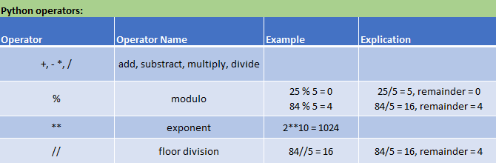
Arithmetic Operators :
print(35/6)
print(3.14*10)
print(10+41)
print(10%4)
print(5**2) (5+9)*(15-7)

Slide 24
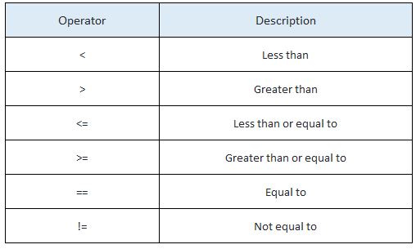
Relational Operators:
a=10
b=10
print(a<b)
print(a>b)
print(a==b)
print(a<=b)
print(a>=b)

Slide 25
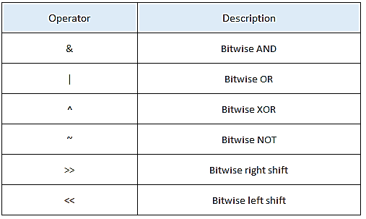
Bitwise Operators:
Bitwise operators act on operands bit by bit as if they are string of binary digits.
a=1
b=2
print(a&b)
print(a|b)
print(a^b)
print(~a)
print(a<<b)
print(a>>b

Slide 26
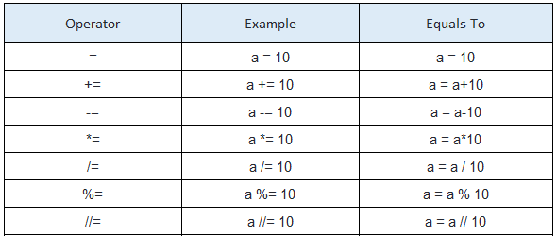
Assignment operators:

Slide 27
Expressions:
An expression is a combination of values, variables, and operators. A value all by itself is considered an expression, and so is a variable, so the following are all legal expressions:
Order of operations:
If more than one operator appears in an expression, the order of evaluation depends on the rules of precedence. For mathematical operators, Python follows mathematical convention. The acronym PEMDAS is a useful way to remember the rules:
Parentheses have the highest precedence. It can be used to force an expression to evaluate in the order you want. Since expressions in parentheses are evaluated first, 2 * (3-1) is 4,
and (1+1)**(5-2) is 8.

Slide 28


Conditional Statements
In daily routine
If it is very hot, I will skip exercise.
If there is a quiz tomorrow, I will first study and then sleep. Otherwise, I will sleep now.
If I have to buy coffee, I will go left. Else I will go straight.

Slide 29
if-else statement
Compare two integers and print the min.
if x < y:
print (x)
else:
print (y)
print (‘is the minimum’)
Check if x is less than y.
If so, print x
Otherwise, print y.

Slide 30
Indentation
Indentation is important in Python
grouping of statement (block of statements)
no explicit brackets, e.g. { }, to group statements
x,y = 6,10
if x < y:
print (x)
else:
print (y)
print (‘is the min’)
Run the program
x
y
6
10
skipped
Output
6

Slide 31
if statement (no else!)
General form of the if statement
Execution of if statement
First the expression is evaluated.
If it evaluates to a true value, then S1 is executed and then control moves to the S2.
If expression evaluates to false, then control moves to the S2 directly.
if boolean-expr :
Statement1
Statement2
true
false
S1
S2

Slide 32
if-else statement
General form of the if-else statement
Execution of if-else statement
First the expression is evaluated.
If it evaluates to a true value, then S1 is executed and then control moves to S3.
If expression evaluates to false, then S2 is executed and then control moves to S3.
S1/S2 can be blocks of statements!
if boolean-expr :
Statement1
else:
Statement2
Statement3
true
false
S1
S2
S3

Slide 33
Nested if, if-else
if a <= b:
if a <= c:
…
else:
…
else:
if b <= c) :
…
else:
…

Slide 34
Elif
A special kind of nesting is the chain of if-else-if-else-… statements
Can be written elegantly using if-elif-..-else
if cond1:
s1
else:
if cond2:
s2
else:
if cond3:
s3
else:
…
if cond1:
s1
elif cond2:
s2
elif cond3:
s3
elif …
else
last-block-of-stmt

Slide 35
Summary of if, if-else
if-else, nested if's, elif.
Multiple ways to solve a problem
issues of readability, maintainability
and efficiency

Slide 36
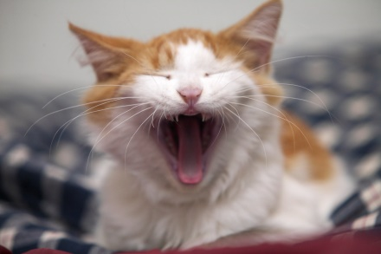
Class Quiz
What is the value of expression:
Run time crash/error
I don’t know / I don’t care
False
True
(5<2) and (3/0 > 1)
The correct answer is
False

Slide 37
CONDITIONAL EXECUTION
if Statement
We mostly need the ability to check conditions and change the behavior of the program accordingly.
The Boolean expression after the if statement is called the condition. We end the if statement with a colon character (:) and the line(s) after the if statement are indented.
Example
x=10 if x > 0 : print('x is positive')

Slide 38
if-else Statement
In this case there are two possibilities and the condition determines which one gets executed.
x=11
if x%2 == 0 :
print('x is even')
else :
print('x is odd')
x is odd

Slide 39
Chained conditionals: if…elif…else
Sometimes there are more than two possibilities. Therefore you need more than two branches. So, it can be Computed by Chained Conditions.
a=10
b=20
if a < b:
print('a is less than b')
elif a > b:
print('a is greater than b')
else:
print('a and b are equal')

Slide 40
Catching exceptions using try and except:
There is a conditional execution structure built into Python to handle certain types of expected and unexpected errors called “try / except”.
The idea of try and except is that you know that some sequence of instruction(s) may have a problem and you want to add some statements to be executed if an error occurs otherwise Ignore
try:
i = int(input("Enter a number\n"))
print(i)
except:
print("Please enter a number")

Slide 41
Function
A function is a block of code which only runs when it is called.
You can pass data, known as parameters, into a function.
A function can return data as a result.
Creating a Function
In Python a function is defined using the def keyword:
Example
def my_function(): print("Hello function test")

Slide 42
Calling a Function
To call a function, use the function name followed by parenthesis:
def my_function(): print("Hello from a function") my_function()
Arguments
Information can be passed into functions as arguments.
Arguments are specified after the function name, inside the parentheses.
You can add as many arguments as you want, just separate them with a comma.

Slide 43
Argument Example
def my_function(fname):
print(fname + " Student")
my_function("Bilal")
my_function("Fahad")
my_function("Nimra")
Python provides a number of important built-in functions.
print(max(1,2,3,4,5)) print(min(1,2,3,4,5))

Slide 44
PYTHON LOOPS
FOR LOOP
A for loop is used for iterating over a sequence (that is either a list, a tuple, a dictionary, a set, or a string).
arr=[1,2,3,4,5]
for i in arr:
print(i)

Slide 45
While Loop
One form of iteration in Python is the while statement. Flow of execution for a while statement:
1. Evaluate the condition is True or False.
2. If the condition is false, exit the while statement and continue execution at the next statement.
3. If the condition is true, execute the body and then go back to step 1.
Infinite loop and Break
n = 10
while n <15 :
print(n) n = n + 1
print(‘Batch 2022')

Slide 46
The range() function in Python:
You can generate a sequence of numbers using range() function.
arr = ["A","B","C","D"]
# iterate over the list using index
for i in range(len(arr)):
print(arr[i])

Slide 47
Finishing iterations with continue in Python:
for i in "Make Me analyst M":
if i == "M":
continue
print(i)
print("STOP")

Slide 48
Finishing iterations with continue in Python:
With the continue statement we can stop the current iteration, and continue with the next:
Task: Continue to the next iteration if i is 3:
i = 0 while i < 6: i += 1 if i == 3: continue print(i)
OUTPUT
1 2 4 5 6

Slide 49
Example2:
i=0
list_numbers = [3, 1, 2, 3, 3, 4, 5, 6, 3, 7, 8, 9, 10]
while i< len(list_numbers):
if list_numbers[i] == 3 :
i += 1
continue
print (list_numbers[i])
i += 1

Slide 50
Skip 1st Index element
list = [0, 1, 2, 3,4,5]
for element in list[1:]:
print(element)

Slide 51
The break Statement
With the break statement we can stop the loop even if the while condition is true
Task: Exit the loop when i is 3:
i = 1 while i < 6: print(i) if i == 3: break i += 1

Slide 52
The else Statement
With the else statement we can run a block of code once when the condition no longer is true:
Task: Print a message once the condition is false:
i = 1
while i < 6:
print(i)
i += 1
else:
print("i is no longer less than 6")

Slide 53
SUMMARY
Introduction to Python
Installing Python in Windows
Python Values, Variables and Types
Python Variable Names and Keywords
Python Statements
Python Operators and Expressions
Take input from User in Python
Python Comments
Python Conditional Execution
Python Functions
Python Loops
Python Strings
Python Lists
Python Dictionaries

